Slide 1
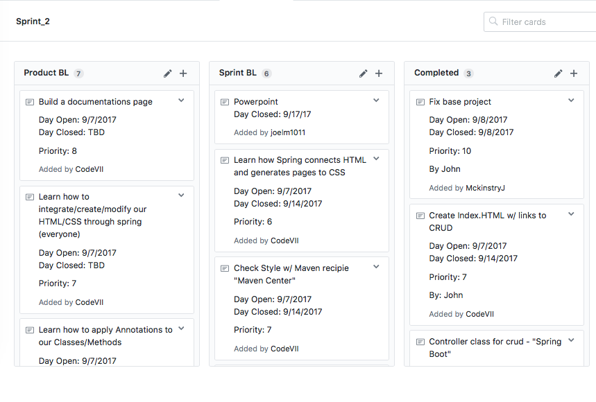
Team Four Sprint 2
Joel, Diego, John, Nick, Chris

Slide 2
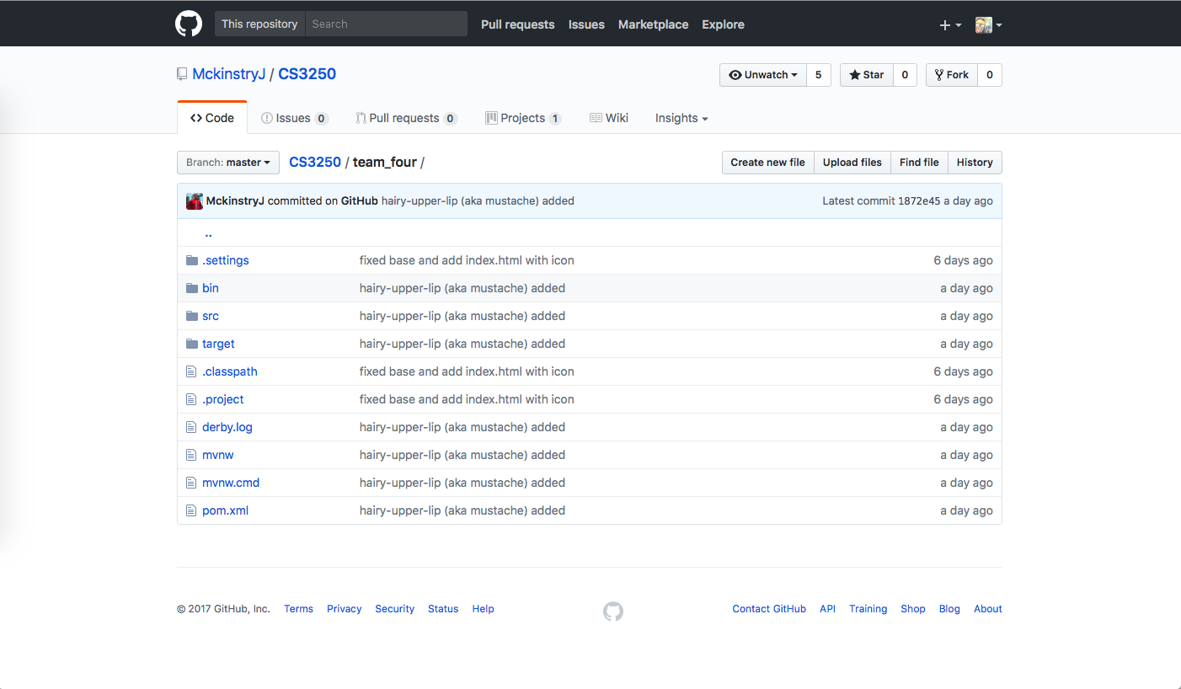
Github

Slide 3
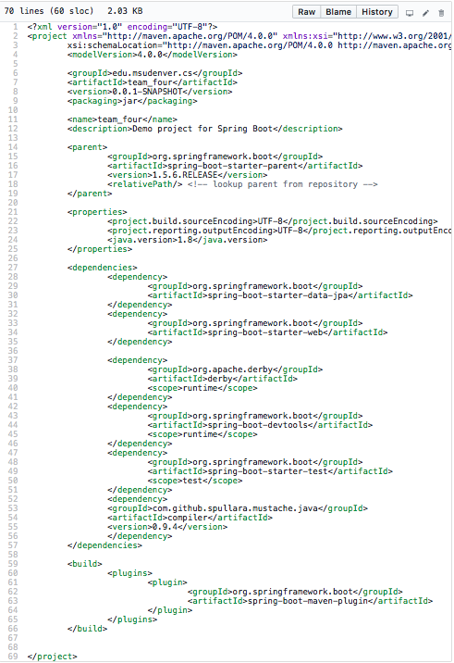
Spring Dependencies (pom.xml)

Slide 4
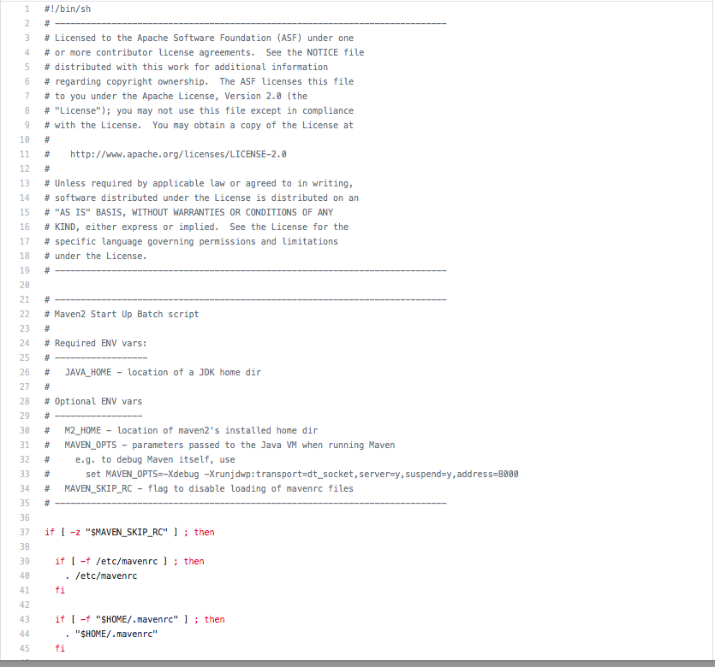
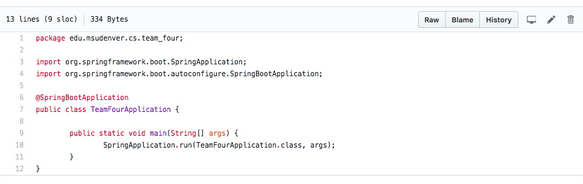
Maven license Spring Main Application

Slide 5
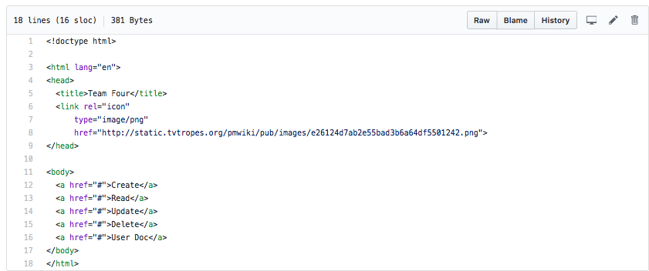
Index.html: Mustache added

Slide 6
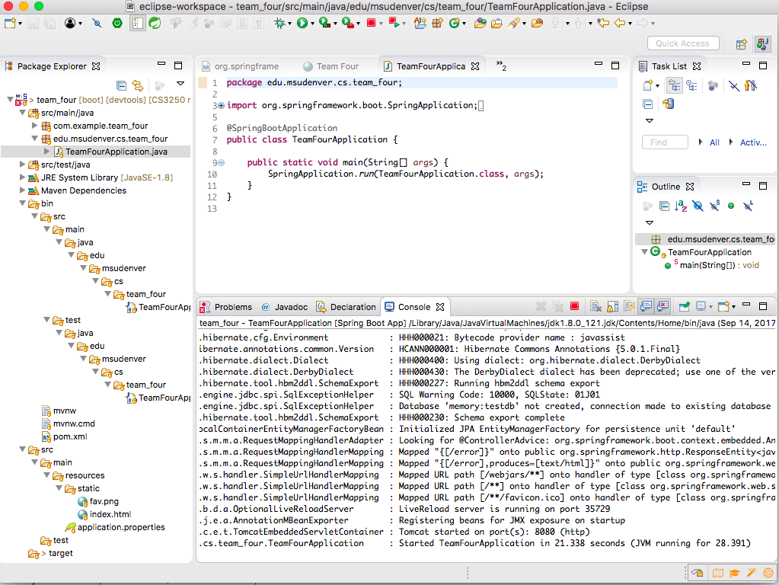
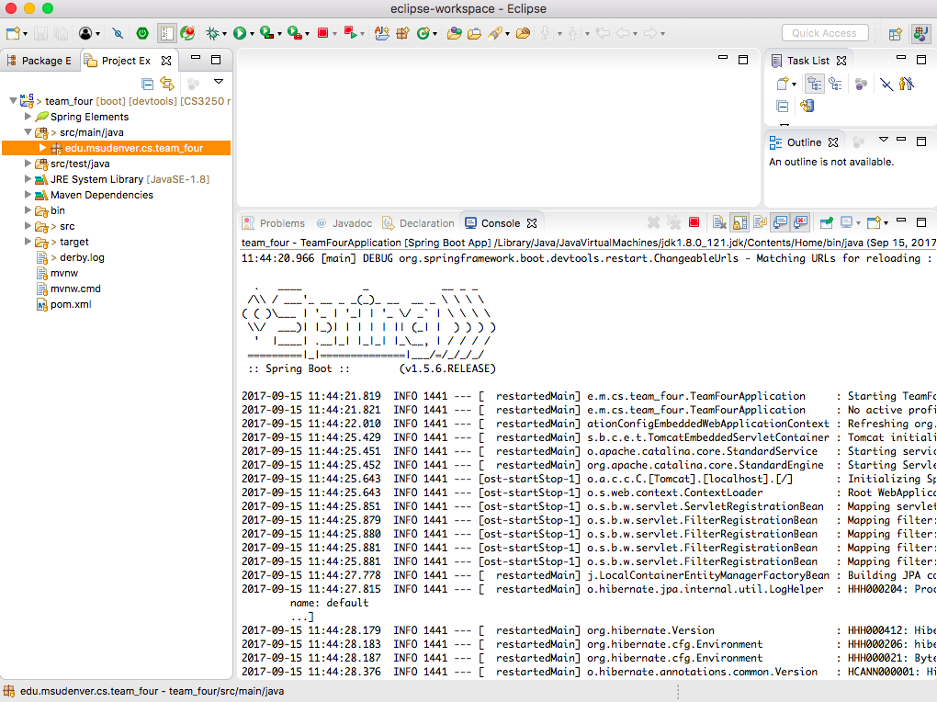
Running Spring Boot App.

Slide 7
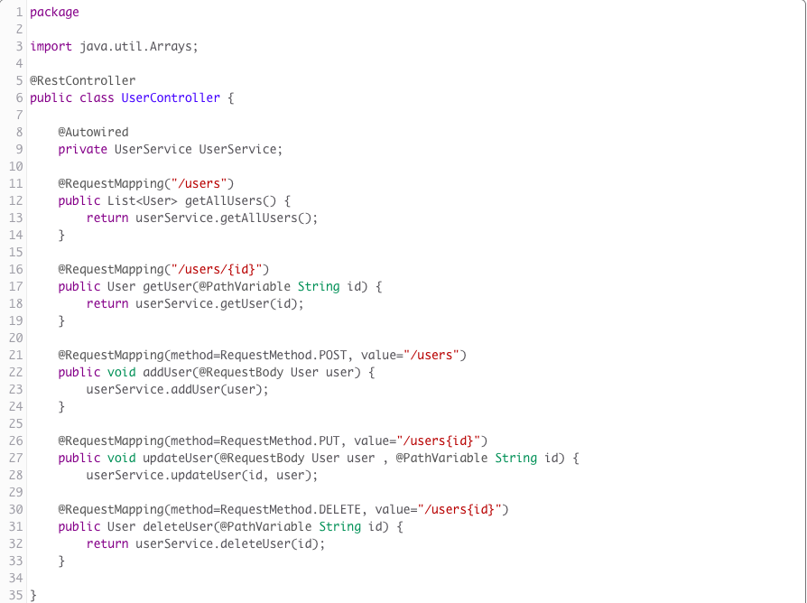
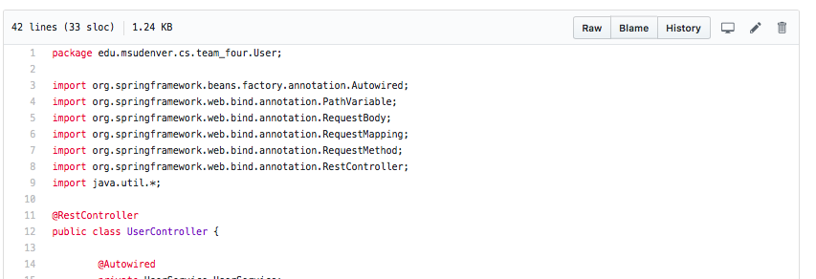
Controller Class

Slide 8
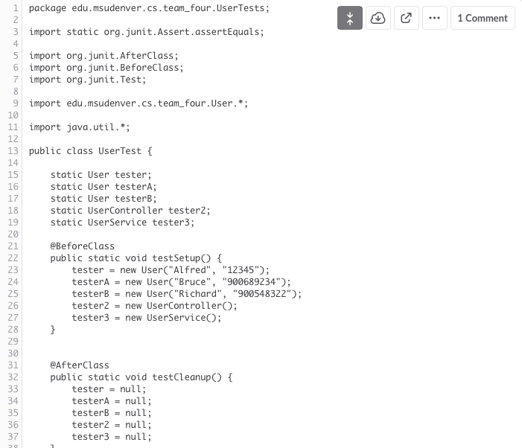
Unit Test

Slide 9
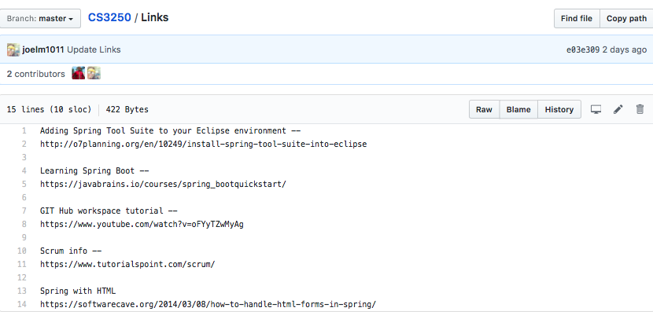
Links

Slide 10
Retrospective
What went well
Fast jump on spring framework, great communication with one and another.
What could have gone better
Getting our cards done sooner rather then last minute.
What we will commit to improve
Timing on getting tasks finished

